Slide 1
A Mobile Information Kiosk for Visitors with navigation of Buildings using AR
Chan Kwok Chi

Slide 2
Problem and aim
From daily observation, people have a delay in information acquisition. They often don’t know the exact position or related information of dynamic/static objects inside an unfamiliar building.
problem
This problem could be solved if a mobile app provides information services and navigation.
This project aims at building a mobile app to provide information services as well as navigation to users instantly with AR techniques so that they could explore a building in a short time.
aim

Slide 3
Methodologies
Build a system raised at Aim
Test the system if it could help to solve the problem
Build and Test
ARCore, the toolkit that provides API for developing mobile app.
MongoDB, the database that can store data of objects flexibly.
Web page technologies, which can form an entry for building managers or users to input information of indoor objects.
Technologies

Slide 4
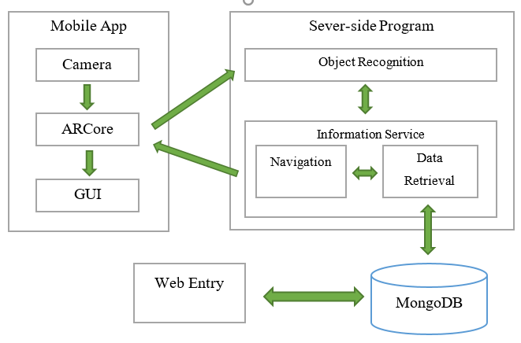
System components
Mobile App
ARCore
GUI
Camera
Server-side program
Recognition
Information service
Database
Web entry

Slide 5
Data flow
Camera first captures live scene and sends to ARCore component
ARCore component then sends live captures to server
Object identity will ben sent to information service. Most recent live captures will be sent to navigation component
Database then sends information(position and the other related) to information service and navigation program respectively
All information will be sent back together to the client app
Virtual objects can be drawn onto the GUI according to those information
Object recognition
camera
Live capture
Live capture
Object identity
Live capture
ARCore
All information
navigation
Information service
Virtual objects
GUI
Navigation computation
Related information
position information
user
database

Slide 6
Evaluation plan
OUHK will be set as experimental site
Let students or staffs in school use this app and collect their feedback
Evaluate the app from different aspects, such as performance, accuracy and usability

Slide 7

Thank you!

